Slide 1

CONSTRAINTS IN ROBLOX

Slide 2
COURSE TIMELINE
Programming Projects with Lua
Roblox Studio Basics
Constraints Pt 1
Constraints Pt 2
Intro to Lua
Parameters
Loops & Conditionals
Functions
W1
W2
W3
W4
W5
W6
W7
W8

Slide 3

Edmodo
Resource Hub
Slides
Learning Material
Exercises/ Assignments / Quizzes
Tutorial Videos
WHEN TO CHECK
FRIDAY AFTERNOON EVERY WEEK
Communication
Directly message teachers
Post Questions
Post Screenshots of your work

Slide 4
TODAY’S LESSON
1
OBSTACLE COURSE GAME
2
NEW TOPIC: CONSTRAINTS
3
CLASS ACTIVITY
4
CLASS PROJECT: RACING GAME

Slide 5
CONSTRAINTS: HOW TO MOVE OBJECTS IN ROBLOX
A Constraint is a link between two physical objects.
TYPES OF CONSTRAINTS
BALL-IN SOCKET
HINGES
PRISMATIC
CYLINDRICAL
WELDS

Slide 6
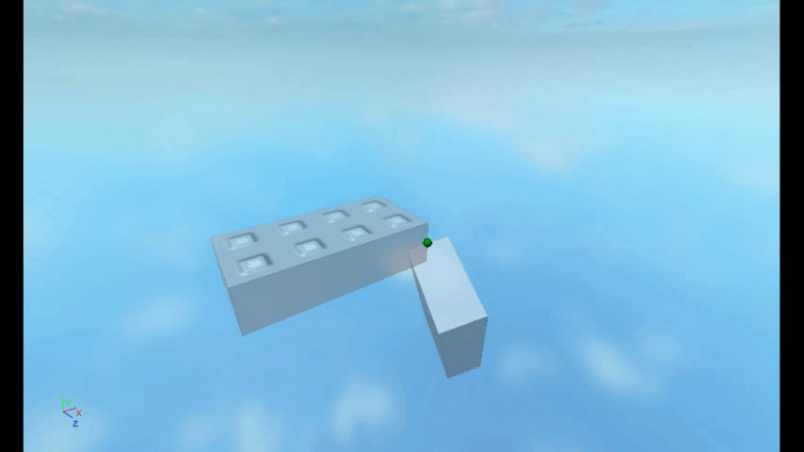
BALL- IN SOCKET
FEATURES
Constrain attachments so they occupy the same position. The attachments can freely rotate about all of their axes by default.

Slide 7
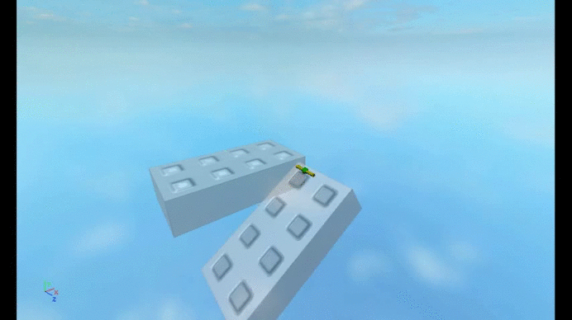
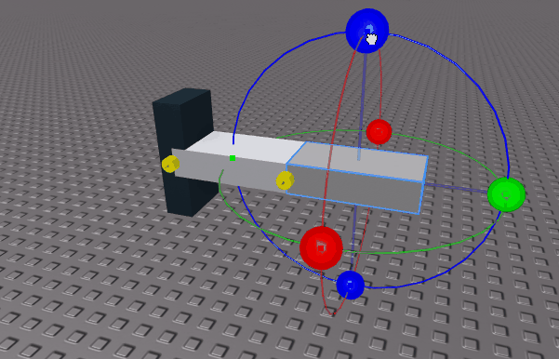
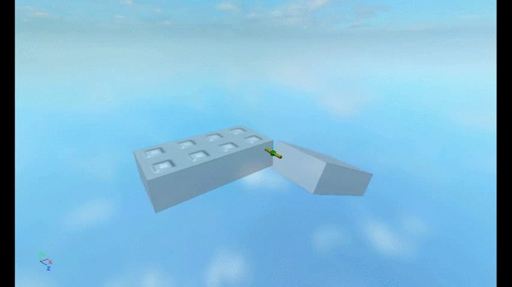
HINGES
FEATURES
Constrain attachments so they occupy the same position and their x-axes point in the same direction.
As you can see, the constraint also allows for motorized or free rotation about an axis. Angular limits can be applied for further customization.

Slide 8
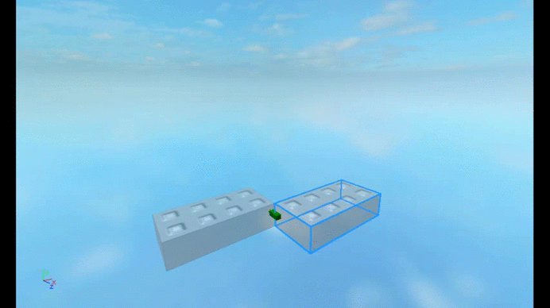
PRISMATIC CONSTRAINT
FEATURES
If you’re using a Prismatic Constraint, the motion is constrained to translation (no rotation) about an axis.
You can also have linear motorized motion and position limits.

Slide 9
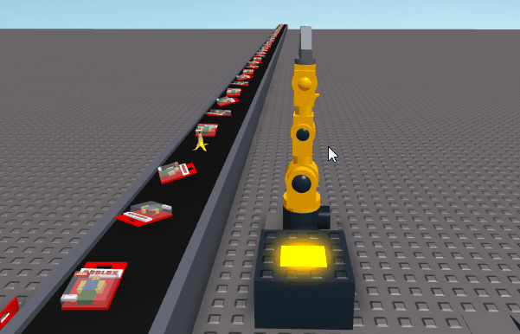
CYLINDRICAL CONSTRAINT
FEATURES
Constrain attachments so they occupy the same position. The attachments can freely rotate about all of their axes by default.

Slide 10
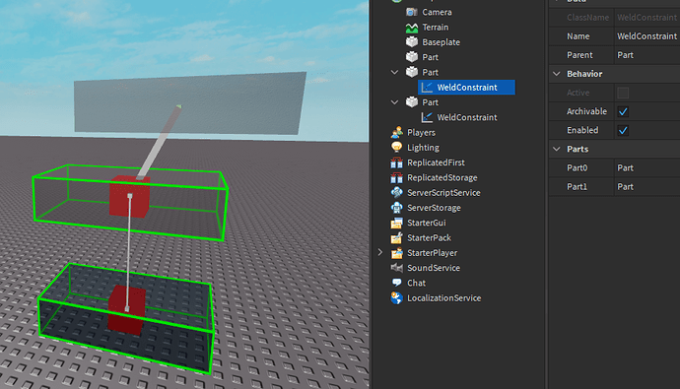
WELDS
FEATURES
Constrain attachments so they occupy the same position. The attachments can freely rotate about all of their axes by default.

Slide 11
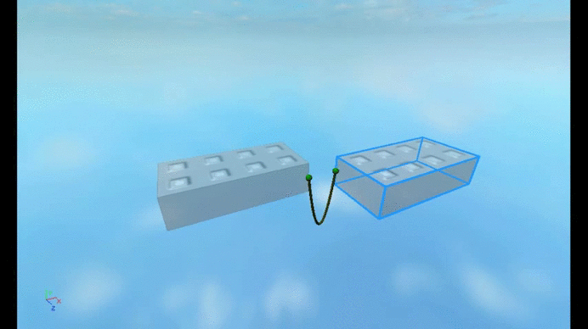
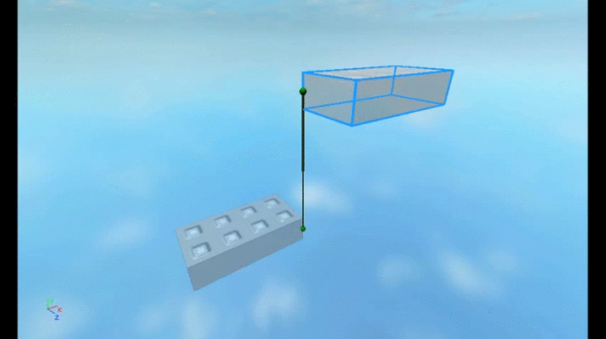
OTHER CONSTRAINTS
ROPE CONSTRAINT
ROD CONSTRAINT
constrain two attachments such that they are not separated from one another further than a specified distance.
Constrain two attachments at a fixed distance, but they can both rotate freely.

Slide 12
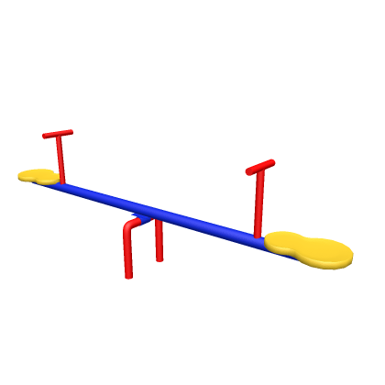
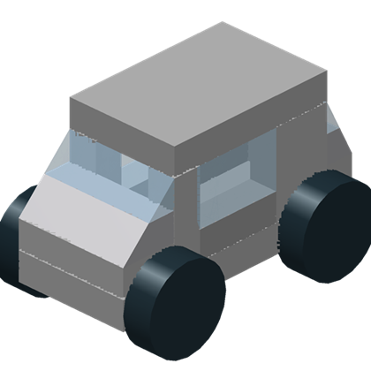
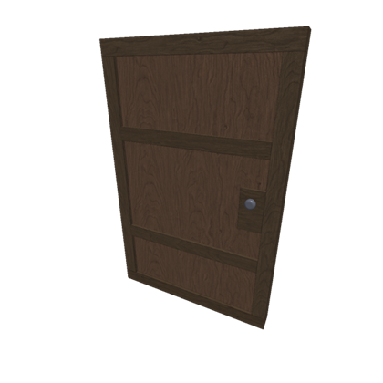
LET’S NAME SOME REAL LIFE EXAMPLES
DOOR
SEE- SAW
CAR

Slide 13
CLASS ACTIVITY

Slide 14
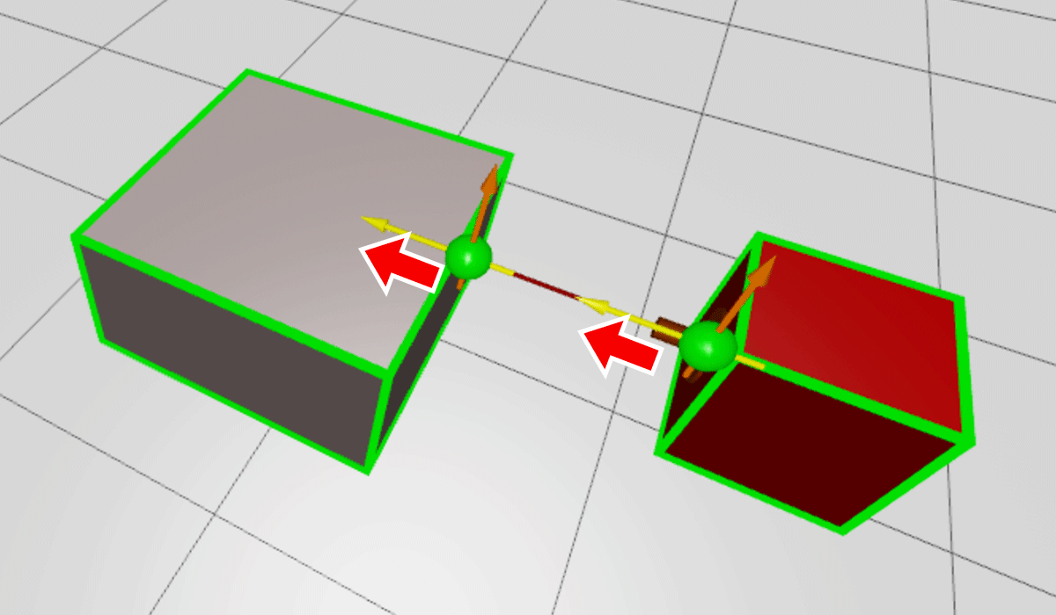
Handy Tips
1.All Constraints come in paris
Remember you use them to link together 2 objects.
2. Constraints have an orientation and position
See how the yellow arrows point in the same direction, for some constraints they also need to be aligned along the same axis.
So the constraint will only work if both the yellow arrows are aligned.

Slide 15
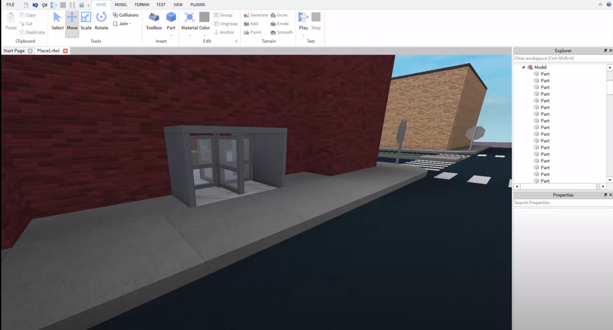
Creating a Revolving Door (Example Video)
Notes:
https://www.youtube.com/watch?v=kkRWNOvKCtY&list=PLuEQ5BB-Z1PKDygk3xYcdRelMWoNFFe3r&index=2&t=0s

Slide 16
CLASS PROJECT

Slide 17
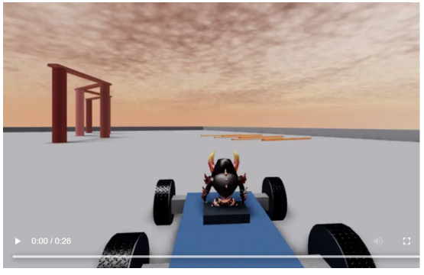
RACING CAR GAME
Notes:
Download the CarKit.rblx Pack
https://developer.roblox.com/assets/blt5d65c328449e57d6/Basic-Car-Create-Cylindrical-Constraint.mp4

Slide 18
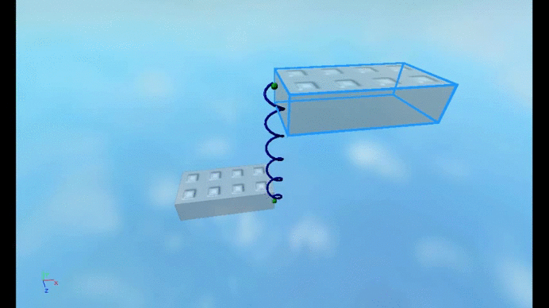
WHAT IS A SPRING?
A spring is a special type of constraint
When using a Spring Constraint, the points on each part will have an equal and opposite applied force based on spring and damper behavior.
String Constraints have a few special properties:
Damping
Stiffness
Limits
Notes:
Introduction to spring systems and their purpose in all physical systems. All physical systems (i.e. a calculator, your phone) are springs and have a limited amount of flex to them. This concept should be relayed to students.
Explanation of properties of different constraints and spring systems, including but not limited to,
Dampening (how long can it be a “spring”?) → Jack in the box winding up
Stiffness (can it be a spring at all?) →
Limits (how much can it “spring”?) → how much it can spring

Slide 19
Getting Started
Download
CarKit.rblx Pack

